Slide 1

Introduction to
Machine Learning
MEDINFO 2015,
T01: Machine Learning Methods
liqi@clickwise.cn

Slide 2
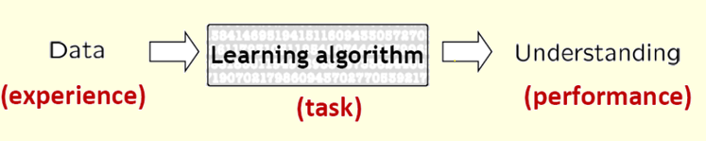
Introduction to Machine Learning
对于某类任务T和性能度量P，如果一个计算机程序在T上以P衡量的性能随着经验E而自我完善，那么我们称这个计算机程序在从经验E中学习。
<P,T,E>

Slide 3
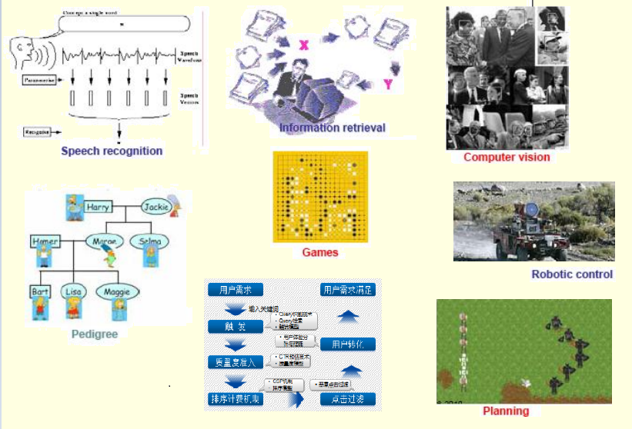
机器学习的一些成功应用

Slide 4
Task
有监督学习 Supervised Learning
分类 Classification
回归 Regression
无监督学习 Unsupervised Learning
密度估计 Density Estimation
聚类 Clustering
降维 Dimensionality Reduction
半监督学习 Semi-supervised Learning
主动学习 Active Learning
增强学习 Reinforcement Learning
Many more …

Slide 5
Task(Example)
有监督学习 Supervised Learning
分类 Classification(SVM, CRF, HMM)
回归 Regression(LR, 决策树)
无监督学习 Unsupervised Learning
密度估计 Density Estimation
聚类 Clustering(LDA, HDP)
降维 Dimensionality Reduction(DL)
半监督学习 Semi-supervised Learning
主动学习 Active Learning
增强学习 Reinforcement Learning
Many more …

Slide 6
Support Vector Machines
Var₁
Var₂

Slide 7
Maximizing the Margin
Var₁
IDEA 1: Select the separating hyperplane that maximizes the margin!
Margin Width
Margin Width
Var₂

Slide 8
Support Vectors
Var₁
Support Vectors
Margin Width
Var₂

Slide 9
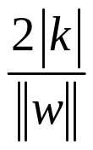


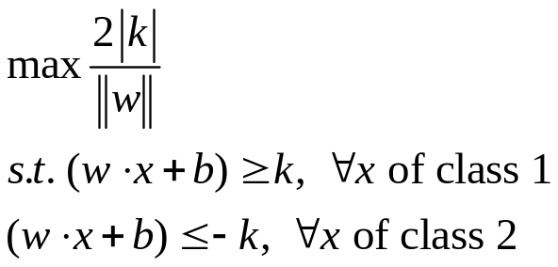



Setting Up the Optimization Problem
Var₁
The width of the margin is:
So, the problem is:
Var₂

Slide 10
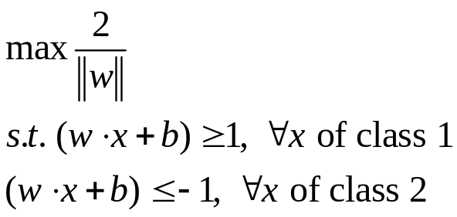



Setting Up the Optimization Problem
Var₁
There is a scale and unit for data so that k=1. Then problem becomes:
Var₂

Slide 11
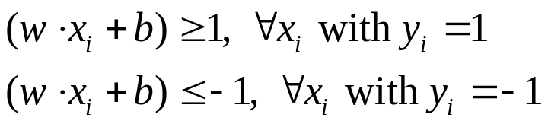

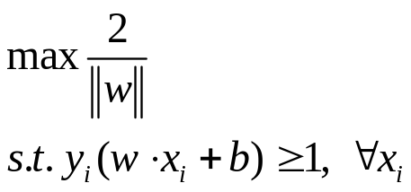
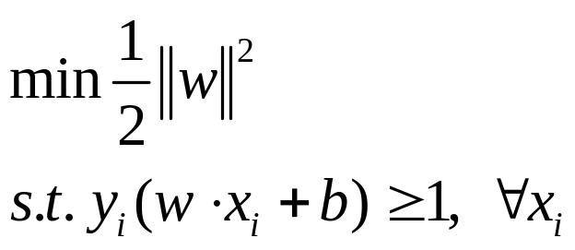
Setting Up the Optimization Problem
If class 1 corresponds to 1 and class 2 corresponds to -1, we can rewrite
as
So the problem becomes:
or

Slide 12
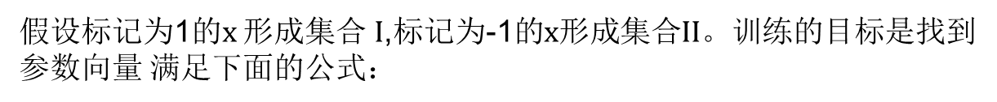

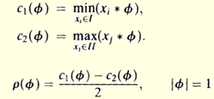
Setting Up the Optimization Problem
假设 是单元量，即向量模为1。

Slide 13











Setting Up the Optimization Problem
假设 是最大化 的点。
和
决定的超平面是
分开样本点I,II
的最大超平面或最优超平面
定理：最优超平面是唯一的，证明略。
一个等价的问题是找到 和 满足：
并且最小化
定理：假设
则

Slide 14
Linear, Hard-Margin SVM Formulation
Find w,b that solves
Problem is convex so, there is a unique global minimum value (when feasible)
There is also a unique minimizer, i.e. weight and b value that provides the minimum
Non-solvable if the data is not linearly separable
Quadratic Programming

Slide 16
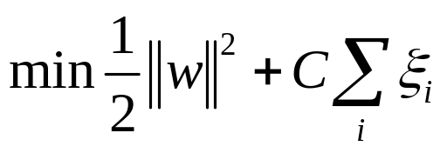
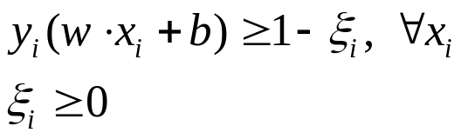
Linear, Soft-Margin SVMs
Algorithm tries to maintain ξ_{i} to zero while maximizing margin
Notice: algorithm does not minimize the number of misclassifications (NP-complete problem) but the sum of distances from the margin hyperplanes
Other formulations use ξ_{i}² instead
As C→∞, we get closer to the hard-margin solution

Slide 17
Robustness of Soft vs Hard Margin SVMs
Var₁
Var₁
ξi
Var₂
Var₂
Soft Margin SVN
Hard Margin SVN

Slide 18
Soft vs Hard Margin SVM
Soft-Margin always have a solution
Soft-Margin is more robust to outliers
  Smoother surfaces (in the non-linear case)
Hard-Margin does not require to guess the cost parameter (requires no parameters at all)

Slide 19
Support Vector Machines
Three main ideas:
  Define what an optimal hyperplane is (in way that can be identified in a computationally efficient way): maximize margin
  Extend the above definition for non-linearly separable problems: have a penalty term for misclassifications
  Map data to high dimensional space where it is easier to classify with linear decision surfaces: reformulate problem so that data is mapped implicitly to this space

Slide 20
Support Vector Machines
Three main ideas:
  Define what an optimal hyperplane is (in way that can be identified in a computationally efficient way): maximize margin
  Extend the above definition for non-linearly separable problems: have a penalty term for misclassifications
  Map data to high dimensional space where it is easier to classify with linear decision surfaces: reformulate problem so that data is mapped implicitly to this space

Slide 21
Disadvantages of Linear Decision Surfaces
Var₁
Var₂

Slide 22
Advantages of Non-Linear Surfaces
Var₁
Var₂

Slide 23
Linear Classifiers in High-Dimensional Spaces
Constructed Feature 2
Var₁
Var₂
Constructed Feature 1
Find function Φ(x) to map to a different space

Slide 24
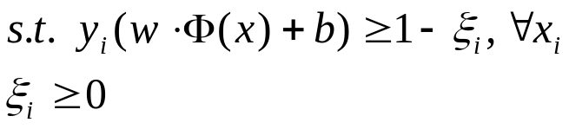
Mapping Data to a High-Dimensional Space
Find function Φ(x) to map to a different space, then SVM formulation becomes:
Data appear as Φ(x), weights w are now weights in the new space
Explicit mapping expensive if Φ(x) is very high dimensional
Solving the problem without explicitly mapping the data is desirable

Slide 25
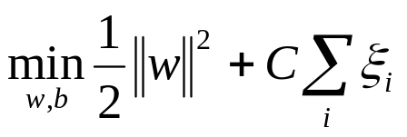
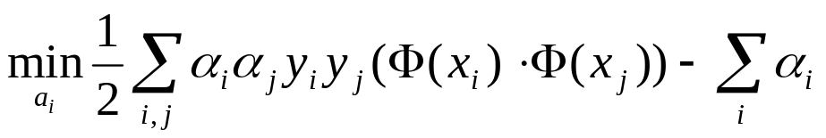
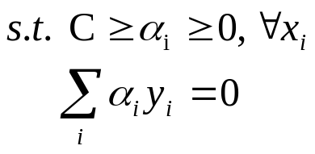
The Dual of the SVM Formulation
Original SVM formulation
  n inequality constraints
  n positivity constraints
  n number of ξ variables
The (Wolfe) dual of this problem
  one equality constraint
  n positivity constraints
  n number of α variables (Lagrange multipliers)
  Objective function more complicated
NOTICE: Data only appear as Φ(x_{i}) ⋅ Φ(x_{j})

Slide 26
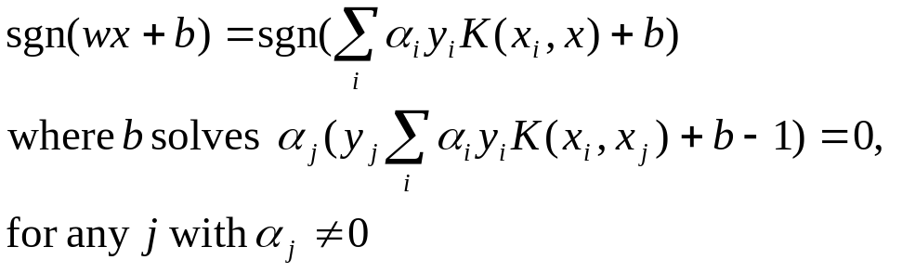
The Kernel Trick
Φ(x_{i}) ⋅ Φ(x_{j}): means, map data into new space, then take the inner product of the new vectors
We can find a function such that: K(x_{i} ⋅ x_{j}) = Φ(x_{i}) ⋅ Φ(x_{j}), i.e., the image of the inner product of the data is the inner product of the images of the data
Then, we do not need to explicitly map the data into the high-dimensional space to solve the optimization problem (for training)
How do we classify without explicitly mapping the new instances? Turns out

Slide 27

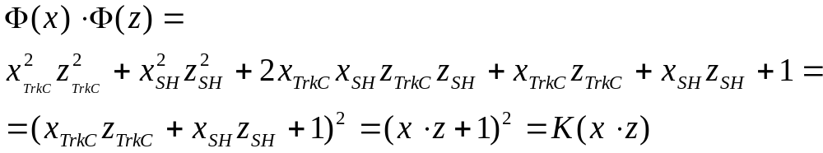
Examples of Kernels
Assume we measure two quantities, e.g. expression level of genes TrkC and SonicHedghog (SH) and we use the mapping:
Consider the function:
We can verify that:

Slide 28

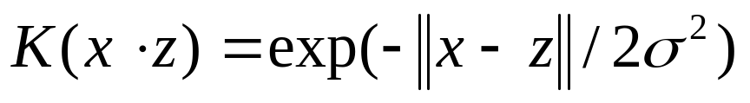
Polynomial and Gaussian Kernels
is called the polynomial kernel of degree p.
For p=2, if we measure 7,000 genes using the kernel once means calculating a summation product with 7,000 terms then taking the square of this number
Mapping explicitly to the high-dimensional space means calculating approximately 50,000,000 new features for both training instances, then taking the inner product of that (another 50,000,000 terms to sum)
In general, using the Kernel trick provides huge computational savings over explicit mapping!
Another commonly used Kernel is the Gaussian (maps to a dimensional space with number of dimensions equal to the number of training cases):

Slide 29
The Mercer Condition
Is there a mapping Φ(x) for any symmetric function K(x,z)? No
The SVM dual formulation requires calculation K(x_{i} , x_{j}) for each pair of training instances. The array G_{ij} = K(x_{i} , x_{j}) is called the Gram matrix
There is a feature space Φ(x) when the Kernel is such that G is always semi-positive definite (Mercer condition)

Slide 30
Support Vector Machines
Three main ideas:
  Define what an optimal hyperplane is (in way that can be identified in a computationally efficient way): maximize margin
  Extend the above definition for non-linearly separable problems: have a penalty term for misclassifications
  Map data to high dimensional space where it is easier to classify with linear decision surfaces: reformulate problem so that data is mapped implicitly to this space

Slide 31
Other Types of Kernel Methods
SVMs that perform regression
SVMs that perform clustering
ν-Support Vector Machines: maximize margin while bounding the number of margin errors
Leave One Out Machines: minimize the bound of the leave-one-out error
SVM formulations that take into consideration difference in cost of misclassification for the different classes
Kernels suitable for sequences of strings, or other specialized kernels

Slide 32
Variable Selection with SVMs
Recursive Feature Elimination
  Train a linear SVM
  Remove the variables with the lowest weights (those variables affect classification the least), e.g., remove the lowest 50% of variables
  Retrain the SVM with remaining variables and repeat until classification is reduced
Very successful
Other formulations exist where minimizing the number of variables is folded into the optimization problem
Similar algorithm exist for non-linear SVMs
Some of the best and most efficient variable selection methods

Slide 33
Comparison with Neural Networks
Neural Networks
Hidden Layers map to lower dimensional spaces
Search space has multiple local minima
Training is expensive
Classification extremely efficient
Requires number of hidden units and layers
Very good accuracy in typical domains
SVMs
Kernel maps to a very-high dimensional space
Search space has a unique minimum
Training is extremely efficient
Classification extremely efficient
Kernel and cost the two parameters to select
Very good accuracy in typical domains
Extremely robust

Slide 34
Why do SVMs Generalize?
Even though they map to a very high-dimensional space
  They have a very strong bias in that space
  The solution has to be a linear combination of the training instances
Large theory on Structural Risk Minimization providing bounds on the error of an SVM
  Typically the error bounds too loose to be of practical use

Slide 35
MultiClass SVMs
One-versus-all
  Train n binary classifiers, one for each class against all other classes.
  Predicted class is the class of the most confident classifier
One-versus-one
  Train n(n-1)/2 classifiers, each discriminating between a pair of classes
  Several strategies for selecting the final classification based on the output of the binary SVMs
Truly MultiClass SVMs
  Generalize the SVM formulation to multiple categories
More on that in the nominated for the student paper award: “Methods for Multi-Category Cancer Diagnosis from Gene Expression Data: A Comprehensive Evaluation to Inform Decision Support System Development”, Alexander Statnikov, Constantin F. Aliferis, Ioannis Tsamardinos

Slide 36
Conclusions
SVMs express learning as a mathematical program taking advantage of the rich theory in optimization
SVM uses the kernel trick to map indirectly to extremely high dimensional spaces
SVMs extremely successful, robust, efficient, and versatile while there are good theoretical indications as to why they generalize well

